Slide 1
Finding which borough has the highest rating for sushi places
By Priteesh Jhamna

Slide 2
INTRODUCTION
Too many sushi shops
Since everyone have different taste, it is better to locate the borough with highest rating for sushi places rather than choosing the best restaurant for them

Slide 3
AIM
This project is aimed to help sushi lovers to find in which borough the highest ratings sushi places are located

Slide 4
DATA
Data are collected in 2 ways
Boroughs and Neighbourhoods in NYC: https://cocl.us/new_york_dataset
Sushi restaurants from Foursquare API

Slide 5
METHODOLOGY
During this analysis process, data analysis and visualization such as bar charts will be made in order to find the borough with the sushi place with the best ratings by collecting data from Foursquare

Slide 6
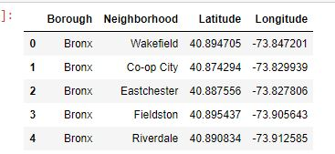
Analysis
Sample of data collected:

Slide 7
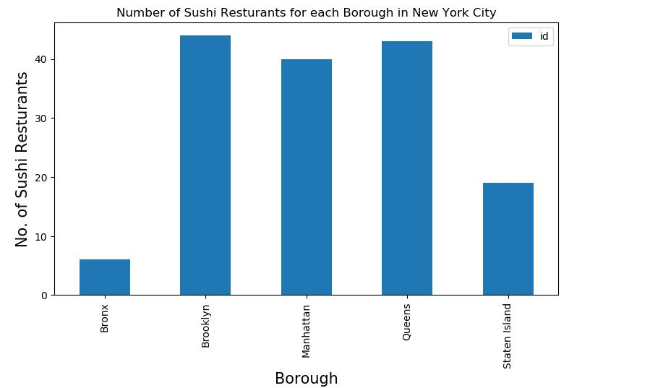
ANALYSIS
Finding the number of sushi place per borough:

Slide 8
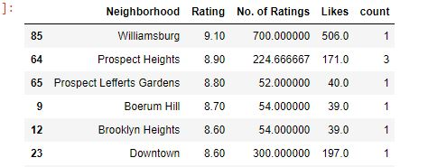
RESULTS
The following is a screenshot of the ratings that was found:

Slide 9
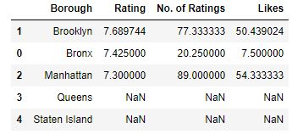
Findings
Sine we are looking or the borough with the highest rating, we group by borough:

Slide 10
DISCUSSION
From the above analysis it has been found that the top three boroughs which have the highest ratings and most likes are Brooklyn, Bronx and Manhattan. This information has made it possible for us to decide that Brooklyn has the highest rating for the best sushi location.

Slide 11
CONCLUSION
In conclusion, this project has made it possible to identify which borough has the highest rating for the best sushi place and has made it easier for sushi lovers to find a location to pick a restaurant to eat from. From the analysis performed in this project, Brooklyn was found to be the borough with the highest rating of 7.69.

